Slide 1
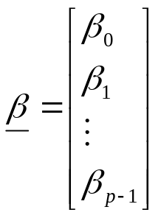
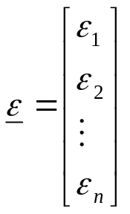
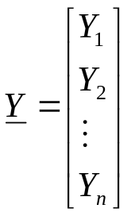
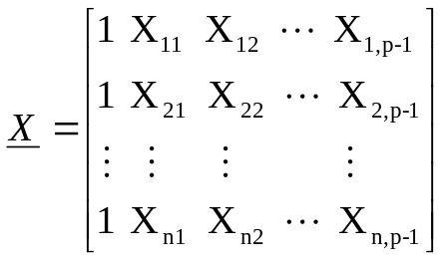
General Linear Model in Matrix Terms
In matrix terms, the general linear regression model is* (the dimensions in the book are wrong)
Y = X β + ε
where
Note, for the first subject then, using matrix multiplication we have
Y₁ = β₀ + β₁X₁₁ + β₂X₁₂ + … β_{p-1}X_{1,p-1} + ε₁
n x 1
n x p
p x 1
n x 1

Slide 2
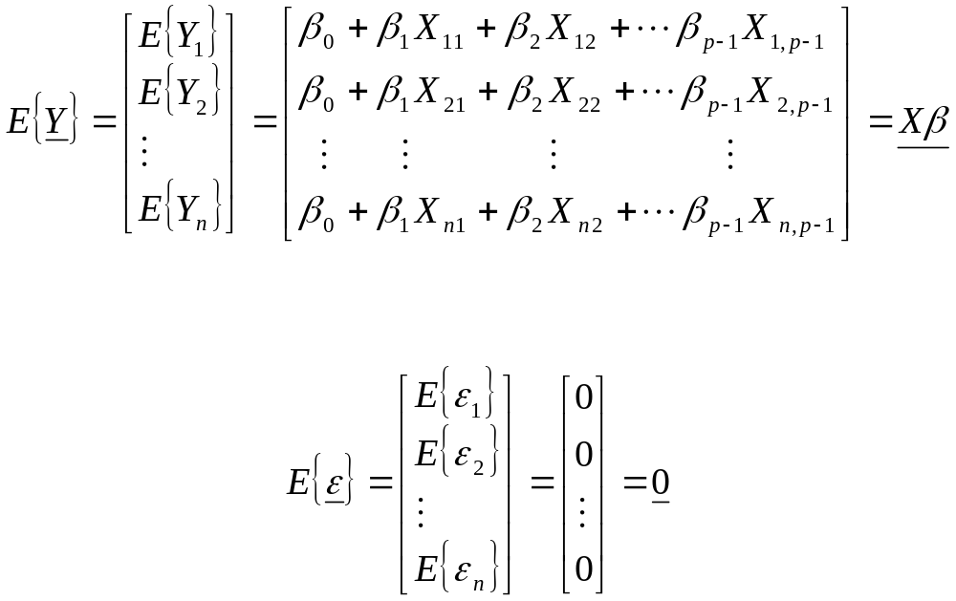
General Linear Model in Matrix Terms
The matrix X is known as the design matrix. It consists of a column of ones and then the values of the predictors. The ones correspond to the β_{o} terms when we apply matrix multiplication. We have that

Slide 3

General Linear Model in Matrix Terms
The covariance of two random variables X and Y, measures the joint dispersion from their respective means. (note for here we are not necessarily thinking of X as a predictor of Y).
The covariance is defined as
Cov(X, Y) = σ_{xy} =
We can also derive that
Cov(X, Y) = E{XY} – E{X}E{Y}
The covariance of X and X is simply the variance of X
Cov(X, X) = E{X²} –(E{X})² = Var(X)

Slide 4
General Linear Model in Matrix Terms
If X and Y are independent than E{XY} = E{X}E{Y} and then the covariance is
Cov(X, Y) = E{XY} – E{X}E{Y} = E{X}E{Y} - E{X}E{Y} =0
The reverse is not necessarily true, that is X and Y can have a covariance of 0 and still be dependent.
The Cov(X,Y) can be positive or negative. Positive covariance implies that large values of X are associated with large values of Y, negative covariance implies that large values of X are associated with small values of Y and vice versa.
The covariance only measures linear associations.

Slide 5
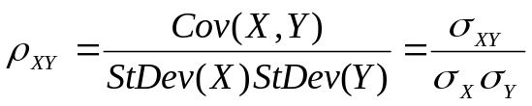
General Linear Model in Matrix Terms
To judge the extent of dependence or association between two random variables, we need to standardize the covariance.
The correlation coefficient is simply the covariance standardized so that its range is [-1, 1]. The correlation coefficient between two random variables X and Y is defined by
Thus both correlation and covariance measure the strength of linear associations between X and Y.

Slide 6
General Linear Model in Matrix Terms
It follows that if X and Y are independent, their correlation is 0 since their covariance is 0.
It can be shown that ρ_{XY} = -1 or 1 if and only if X and Y have a deterministic linear relationship of the form Y = aX + b where a is not 0 and both a and b are constants.
We also have that Cov(X,Y) = Cov(Y,X) or equivalently Cor(X,Y) = Cor(Y,X)
Cov(X, Y) = E{XY} – E{X}E{Y} = E{YX} - E{Y}E{X} = Cov(Y, X)

Slide 7
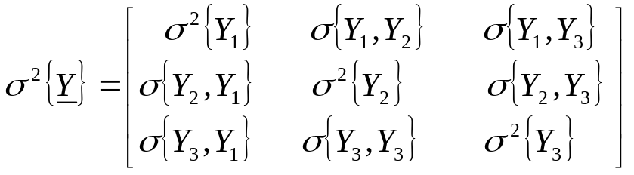
General Linear Model in Matrix Terms
Consider a random vector Y consisting of three observations, Y₁, Y₂, and Y₃.
The variance of the three random variables σ²{Y_{i}}, and the covariances between any two of the random variables σ{Y_{i},Y_{j}}, are assembled in the variance covariance matrix of Y, denoted by σ²{Y} in the following way
Note the variances are found on the diagonal and the covariance σ{Y_{i},Y_{j}} is found in the ith row and jth column.

Slide 8

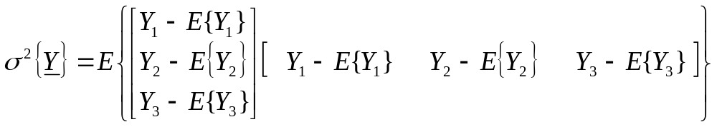
General Linear Model in Matrix Terms
Recall that the covariance of a variable with itself is its variance, thus the variance terms on the diagonal.
Note also that σ{Y_{i},Y_{j}} = σ{Y_{j},Y_{i}} and the variance-covariance matrix σ²{Y} is symmetric.
From our earlier definition, it follows that σ²{Y} =
For our 3 observation example, this gives

Slide 9
General Linear Model in Matrix Terms
We denote the variance-covariance matrix σ²{Y} by ∑.
Recall that the variance of the observations is determined by the variance of the error terms. That is, they both have the same variance σ².
The variance and covariance terms of ∑ are also determined by the variance and covariance terms of the error terms.
Recall that σ²{ε_{i}} = σ² and that the error terms are independent random variables. Thus the diagonals of the variance-covariance matrix σ²{ε} are all σ² and the off diagonal terms are all 0.

Slide 10
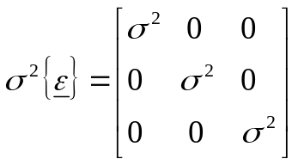
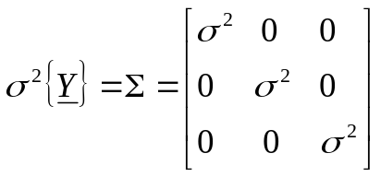
General Linear Model in Matrix Terms
For our example of three observations, we have
In general, we can write σ²{ε} = σ²I where I is the identity matrix.
Again, the variance and covariance terms of σ²{Y} = ∑ are determined by the variance and covariance terms of the error terms. Thus the variance-covariance matrix of Y is the same as that of ε and we have

Slide 11
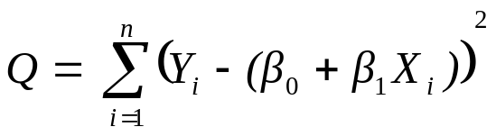
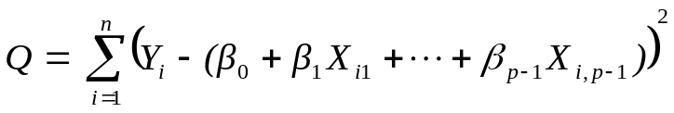
General Linear Model in Matrix Terms
Recall that for simple linear regression, the method of least squares estimators of β₀ and β₁ are the values of β₀ and β₁ that minimize the value of Q for the data. For simple linear regression, we had that
Q is now generalized as follows
The objective of the least squares method is to find estimates b₀,b₁, …, b_{p-1} for β₀, β₁, … β_{p-1} which minimizes Q.

Slide 12
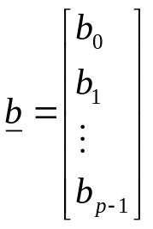
General Linear Model in Matrix Terms
Minimizing Q minimizes the distance the observations are from the estimated values.
We denote the vector of the least squares estimated regression coefficients b₀, b₁, …, b_{p-1} as b
Recall, for simple linear regression, to find the values of b₀ and b₁ that minimized Q, we found the derivatives of Q, with respect to β₀ and β₁.

Slide 13
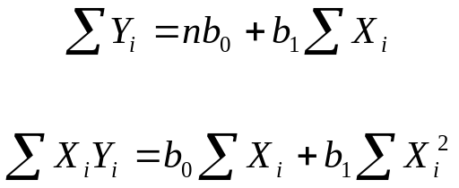
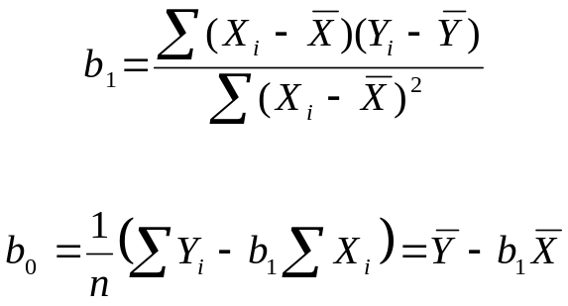
General Linear Model in Matrix Terms
We then set the partial derivatives equal to 0 and solved for b₀ and b₁. Taking the partial derivatives and setting them to 0 gave us the normal equations
The normal equations are then solved simultaneously for b₀ and b₁ giving us our point estimators.

Slide 14
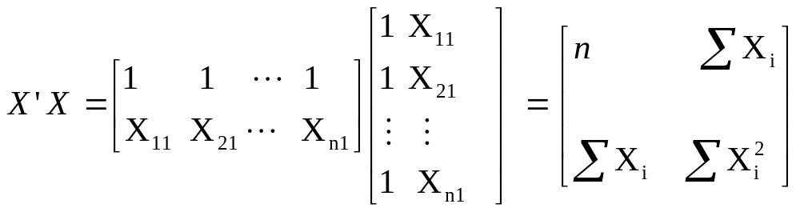
General Linear Model in Matrix Terms
In matrix terms, the least squares normal equations for the
general linear regression model are:
X’Xb = X’Y
and the least squares estimators are* (this is also wrong in book)
b = (X’X)⁻¹ (X’Y)
Consider the case of simple linear regression

Slide 15
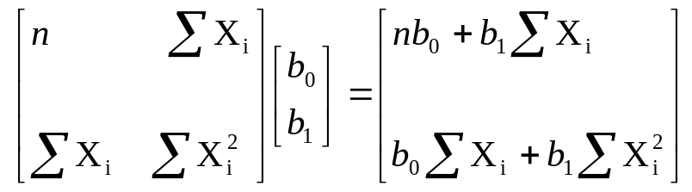
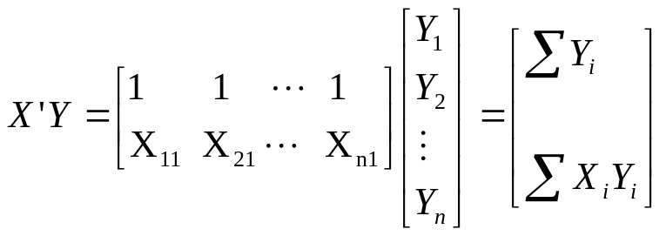
General Linear Model in Matrix Terms
Thus X’Xb is
and X’Y is

Slide 16
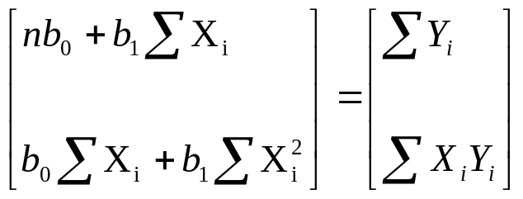
General Linear Model in Matrix Terms
Therefore X’Xb = X’Y yields
which are our normal equations for simple linear regression.

Slide 17
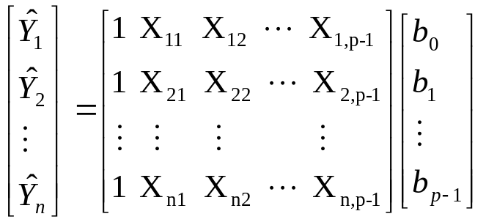
General Linear Model in Matrix Terms
The vector of the fitted values Y_{i}(hat) is denoted by Y(hat)
and we have that Y(hat) = Xb
For simple linear regression, this would be
For the first subject then, using matrix multiplication we have
Y(hat)₁ = b₀ + b₁X₁₁ + b₂X₁₂ + … + b_{p-1}X_{1,p-1}

